Slide 1
Using Adaptive Cards control from the PnP control gallery in SPFx solutions
Fabio Franzini – CEO Apvee Solutions – Microsoft MVP

Slide 2
Agenda
Understanding the reason behind the implementation of this control
Why I chose to use the Adaptive Cards SDK
Introduction to the control, how it was implemented and how to use it in SPFx
Same code, different scenarios
Demo
Next Steps
References

Slide 3
Understanding the reason behind the implementation of this control
Very often, in my development activities, customers ask me SPFx components with identically functionality, but which may differ for the UI part.
This led me to think of a way to have the ability to “change” the UI at runtime, without having to recompile the SPFx solution.
After several attempts and reasoning, the choice fell on Adaptive Cards.

Slide 4
Why I chose to use the Adaptive Cards SDK
Adaptive Cards are platform-agnostic snippets of UI, authored in JSON, that apps and services can openly exchange. When delivered to a specific app, the JSON is transformed into native UI that automatically adapts to its surroundings. It helps design and integrate light-weight UI for all major platforms and frameworks.
The goals for Adaptive Cards are:
Portable - To any app, device, and UI framework
Open - Libraries and schema are open source and shared
Low cost - Easy to define, easy to consume
Expressive - Targeted at the long tail of content that developers want to produce
Purely declarative - No code is needed or allowed
Automatically styled - To the Host application UX and brand guidelines

Slide 5
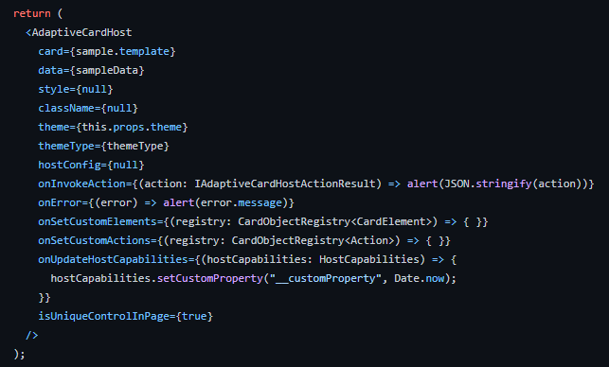
Introduction to the control, how it was implemented and how to use it in SPFx
React Control that render an Adaptive Card using the SDK
Using a brand-new elements that use the Fluent UI Theme both for SharePoint and Microsoft Teams
Auto apply the AC Template if data object is passed to the control
Callbacks to intercept Actions and Errors
Callbacks to set Custom Elements and Custom Actions
Callback to set custom Host Capability properties

Slide 6
Same code, different scenarios
SharePoint - SPFx Web Part
Teams Tab - SPFx Web Part

Slide 7
DEMO

Slide 8
Next Steps
Implement the Designer component for the PnP Reusable React Controls Library
Create a set of new Adaptive Cards Elements (targeted only for JS SDK)
Maybe using Fluent UI React
Maybe using Fluent UI Web Components
Maybe using MGT (Thanks to João Mendes)
Maybe using another libraries

Slide 9

About Me
I’m CEO at Apvee Solutions, startup focused on building innovative solutions using the Microsoft 365 ecosystem.
I'm a Microsoft MVP in Office Development and Business Applications categories.
Mail: fabio@apvee.com
Twitter: @franzinifabio
LinkedIn: www.linkedin.com/in/fabiofranzini
GitHub: https://github.com/fabiofranzini

Slide 10
References
https://adaptivecards.io/
https://pnp.github.io/sp-dev-fx-controls-react/controls/AdaptiveCardHost/
https://github.com/pnp/sp-dev-fx-webparts/tree/main/samples/react-adaptive-card-host-control

Slide 11
Thank you!
Fabio Franzini – CEO Apvee Solutions – Microsoft MVP

